Slide 1

Intrusion Detection System in Internet of Vehicles
Innovative neural network approach to identify cyber attacks in IoV networks
By-
Prithvi Reddy

Slide 2

Presentation Outline
1
Introduction
IoV concept and security challenges
2
Workflow
Data preprocessing, preparation, model training, evaluation
3
Performance
Results and key metrics
4
Future Scope
Potential improvements and applications

Slide 3

Introduction to IoV Security
IoV Ecosystem
Benefits of IoV
Connected vehicles (V2V), infrastructure, and cloud services(V2X).
Improved traffic efficiency and safety
Security Challenges
Need for IDS
Data breaches, unauthorized access, malware attacks (DOS, spoofing,etc)
Real-time threat detection
and response

Slide 4
Importance of IDS in IoV:
IoV’s Connectivity = Vulnerability
Role of IDS
IoV connects vehicles, infrastructure, and pedestrians.​
Prone to attacks like DoS, spoofing, sniffing, and CAN bus intrusion.
Detects network anomalies to secure vehicular and IoT systems.​
Mitigates threats, ensuring operational safety and efficiency.
Benefits of IDS
Intelligent IDS
Safety: Prevents accidents caused by system hacking.​
Cost Savings: Avoids damages and downtime.​
Efficiency: Maintains seamless traffic and vehicle operations.
ML-powered systems (Neural Network Based solution).​
High detection accuracy with low false alarms.​

Slide 5


Types of Cyberattacks: External Network Attacks (V2X, V2G)
a. Denial of Service (DoS) :
b. Sniffing or Port Scanning:
The attacker sends a large volume of irrelevant or malformed requests to IoV nodes, such as V2X gateways or vehicle infotainment systems.​
These requests overwhelm the network or system resources, leading to denial of legitimate service.​
Purpose in Research:​
Tests the IDS's capacity to distinguish between benign and malicious traffic in high-volume scenarios.​
Tools like port scanners are used to probe open ports on IoV devices or servers to identify vulnerabilities.
Once vulnerabilities are identified, attackers may extract sensitive information or prepare for further ​exploitation.
Purpose in Research:​
Evaluates how well the IDS detects reconnaissance activities.​

Slide 6


Types of Cyberattacks: External Network Attacks (V2X, V2G)
c. Brute Force Attacks​:
d. Web Attacks (SQL Injection, Cross-Site Scripting - XSS):
Repeated attempts are made to guess passwords or cryptographic keys for network or vehicle system authentication.​
For example, attackers might target the vehicle’s web interface or cloud-based management systems.​
Purpose in Research:
Demonstrates the IDS's ability to detect abnormal login patterns and high-volume authentication failures.​​
For SQL injection: Malicious queries are sent to compromise databases storing vehicle or user data.​
For XSS: Malicious scripts are injected into web interfaces or management portals used by vehicles.​
Purpose in Research:​
Tests whether the IDS can flag traffic carrying malicious payloads targeting web interfaces.​​

Slide 7

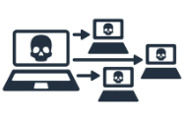
Types of Cyberattacks: External Network Attacks (V2X, V2G)
e. Infiltration:
f. Botnet:
Unauthorized file downloads (e.g., Dropbox) and device-based exploits (e.g., Cool disk) using tools like Meta Exploit.
Two-Step Process: Initial access to a system , followed by reconnaissance using port scans.
Exploits IoV's interconnected nature for lateral movement, risking sensitive data and system controls.
Purpose in Research:
Tests IDS's detection of multi-stage attacks and their impact on network traffic in IoV-like environments.​​
Botnets are networks of compromised devices controlled by an attacker to execute malicious tasks like DDoS, data theft, or unauthorized access.
In IoV, botnets can disrupt vehicle communication (V2V/V2I), compromise vehicle systems, or steal sensitive data, posing significant safety risks.
Purpose in Research:
Simulating botnet attacks like ARES helps model realistic traffic, analyze infected device behavior, and evaluate IDS performance against IoV-specific threats.

Slide 8





Dataset Description: IDS 2017 Dataset
https://www.unb.ca/cic/datasets/ids-2017.html
Realistic Background Traffic Generation: Simulated Human Interaction & Attack Analysis
Data Capture Duration:
From 9 a.m. on Monday, July 3, 2017, to 5 p.m. on Friday, July 7, 2017 (5 days).​
Monday: Only benign traffic recorded.​
Tuesday: attacks + Normal Activity, 11G​
Wednesday: attacks + Normal Activity, 13G​
Thursday: attacks + Normal Activity, 7.8G​
Friday: attacks + Normal Activity, 8.3G
Traffic Simulation with B-Profile System Modeled 25 users' benign activities using protocols like HTTP, HTTPS, FTP, SSH, and email.
Attack Patterns: Implemented attacks include Brute Force FTP/SSH, DoS, Heartbleed, and others in scheduled sessions.

Slide 9
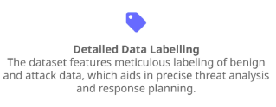
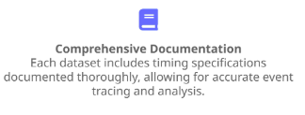
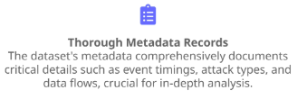
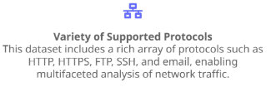
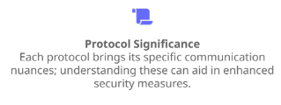
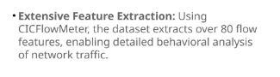
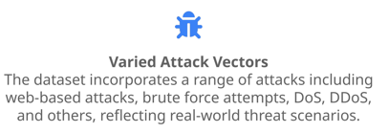
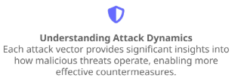
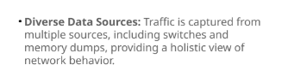
IDS 2017 Dataset: 11 Benchmarking criteria:

Slide 10
MODLE DEVELOPMENT WORKFLOW
MODEL TESTING
MODEL TRAINING
DATA PREPARATION
DATA PREPROCESSING

Slide 11

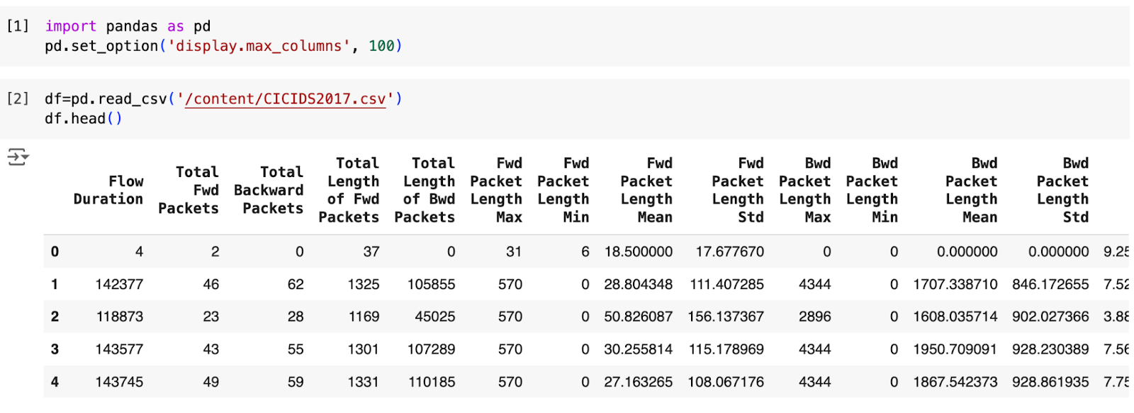
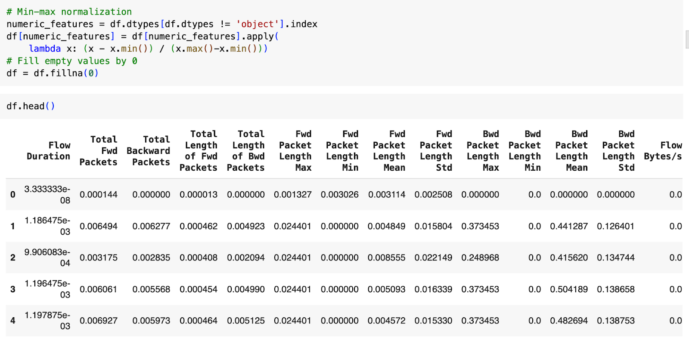
Data Preprocessing
Normalization
Min-Max scaling for consistent data ranges
Why?
Features with larger scales dominate the learning process, skewing the model's weight updates during training.
Min-Max scaling method, in this dataset is to rescale the data into a specified range, [0, 1]

Slide 12
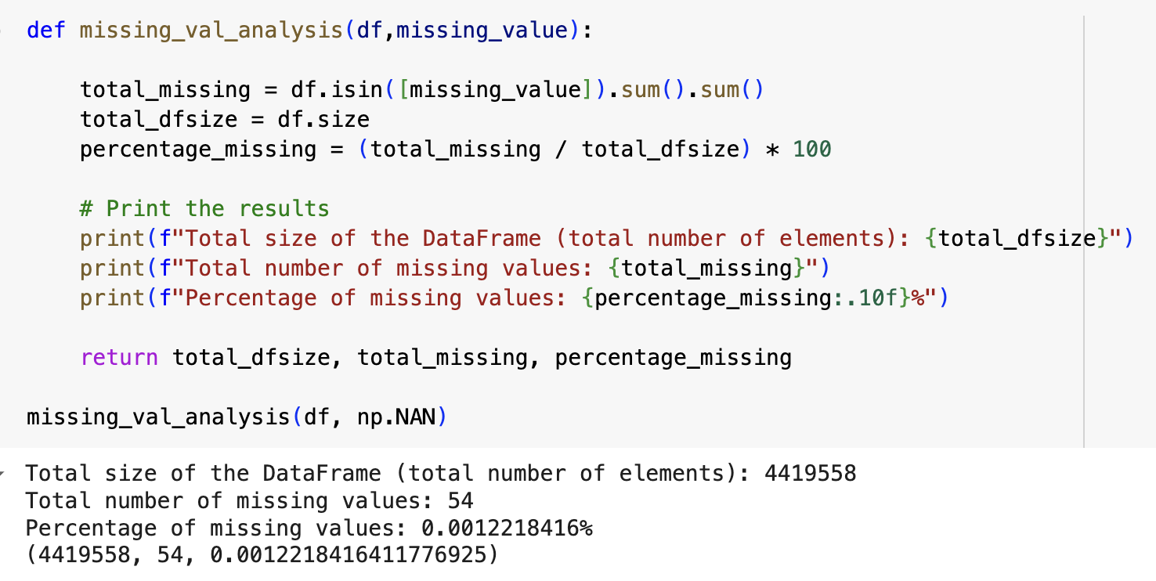
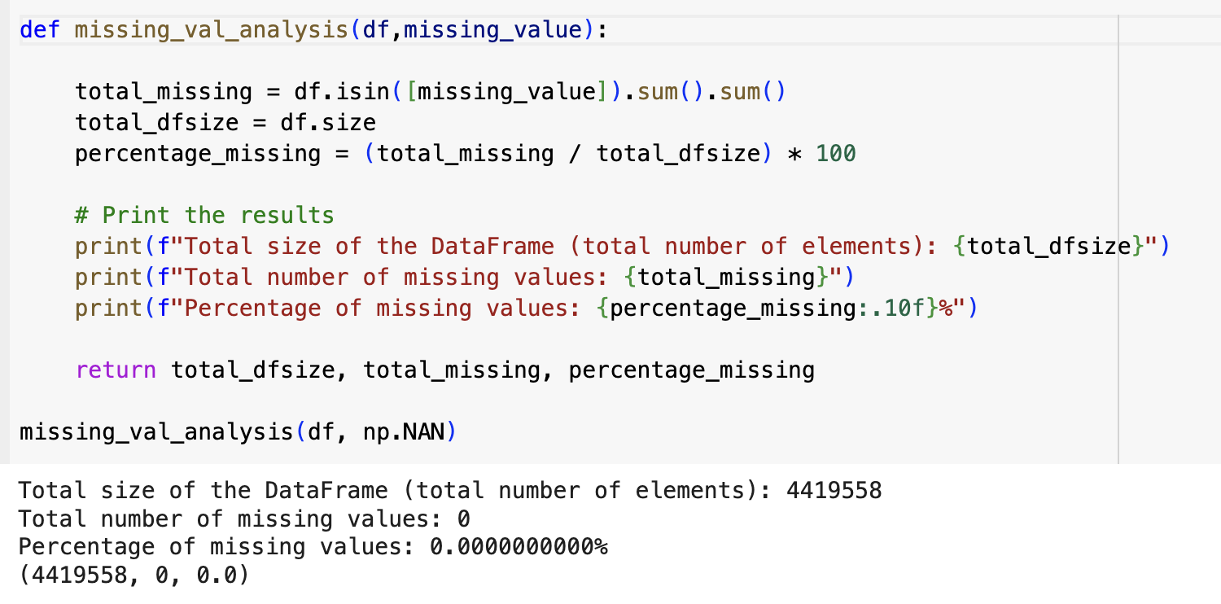
Data Preprocessing
Handling Missing Data
Zero imputation to handle incomplete datasets
Why?
Missing data reduces the completeness of your dataset, making it harder for models to identify patterns or relationships. Handling missing data is essential in machine learning and data analysis because missing values can significantly impact the quality and accuracy of models

Slide 13
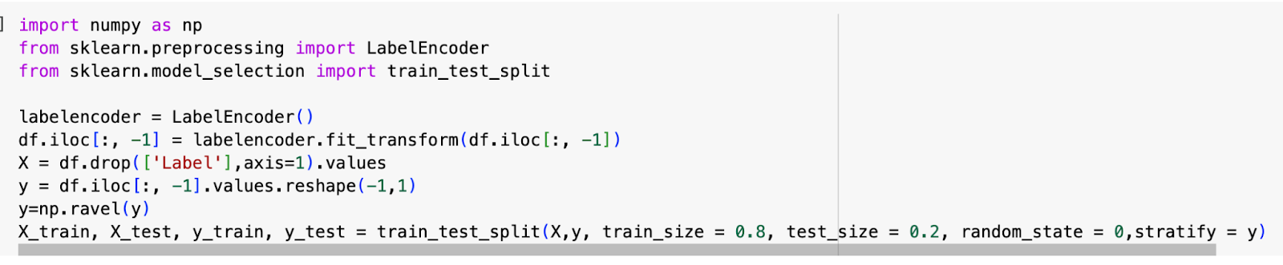
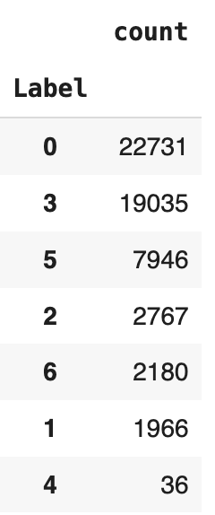
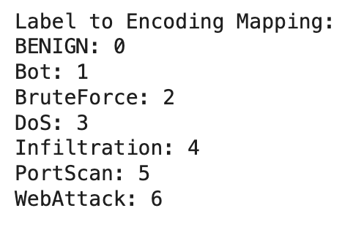
Data Preprocessing
Label Encoding
Convert categorical variables to numerical format
Why?
Most machine learning algorithms (e.g., logistic regression, support vector machines, neural networks) work with numerical data and cannot process categorical data directly.
Label encoding is used to convert categorical data (non-numeric data) into a numerical format, enabling it to be utilized by machine learning algorithms that require numerical input.

Slide 14
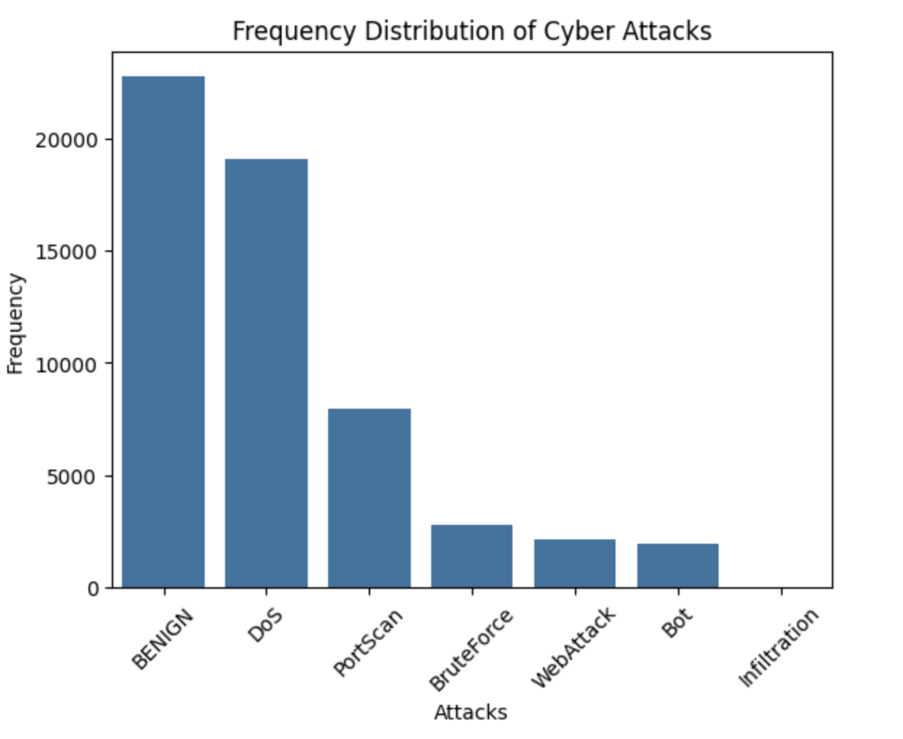
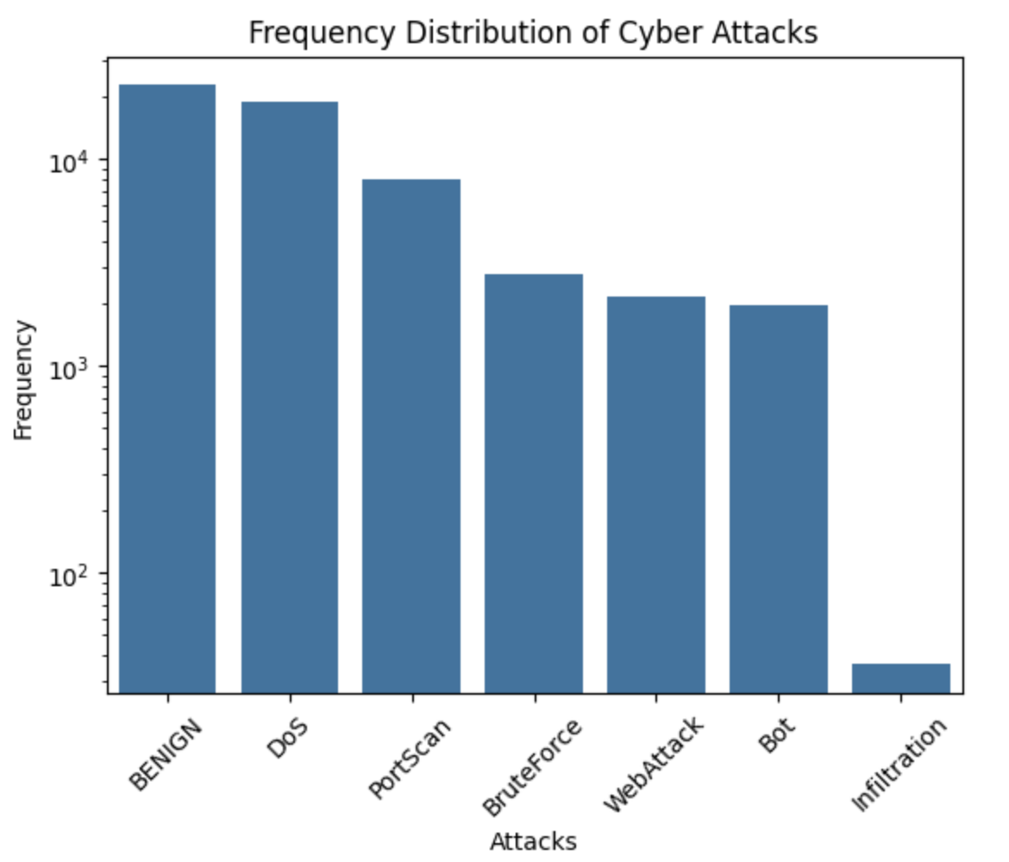
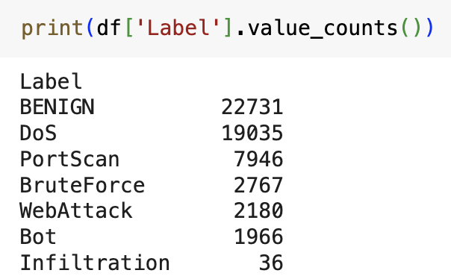
Data Preparation
Class Imbalance Handling
SMOTE technique to generate synthetic samples

Slide 15
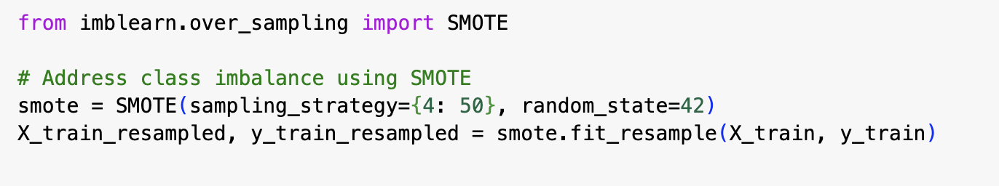
Class Imbalance Handling
SMOTE (Synthetic Minority Oversampling)
SMOTE is an oversampling technique that generates synthetic samples for the minority class to balance the dataset. It creates new samples by interpolating between existing samples of the minority class, rather than simply duplicating them.
For each sample in the minority class, SMOTE identifies its k-nearest neighbors (typically using Euclidean distance) in the feature space. The parameter k determines the number of neighbors to consider, and it is usually set to 5 by default.
A random neighbor is selected from the k-nearest neighbors of a minority class sample.A new synthetic sample is created along the line segment connecting the original sample and its selected neighbor.
Mathematically: Synthetic Sample=xi+λ⋅(xnn−xi)

Slide 16





Model Training
Neural Network Architecture
Multi-layer perceptron using TensorFlow
Hyperparameter Tuning
Optimizing learning rate, batch size, and epochs
Training Process
Iterative learning on preprocessed IoV network data

Slide 17
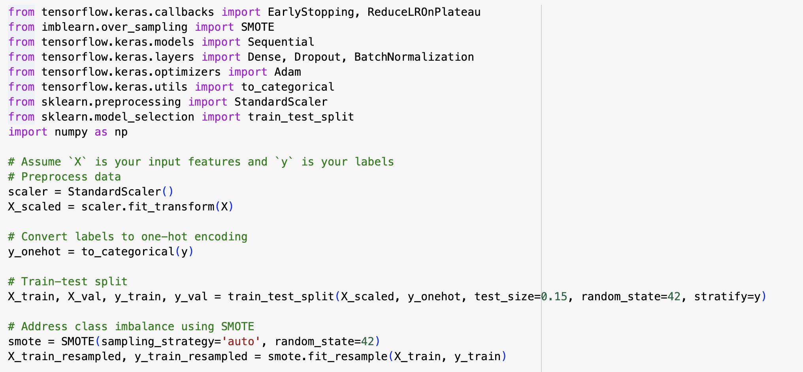
MODEL DEEVLOPMENT
Import the necessary libraries
Split the available data into training and validation data

Slide 18
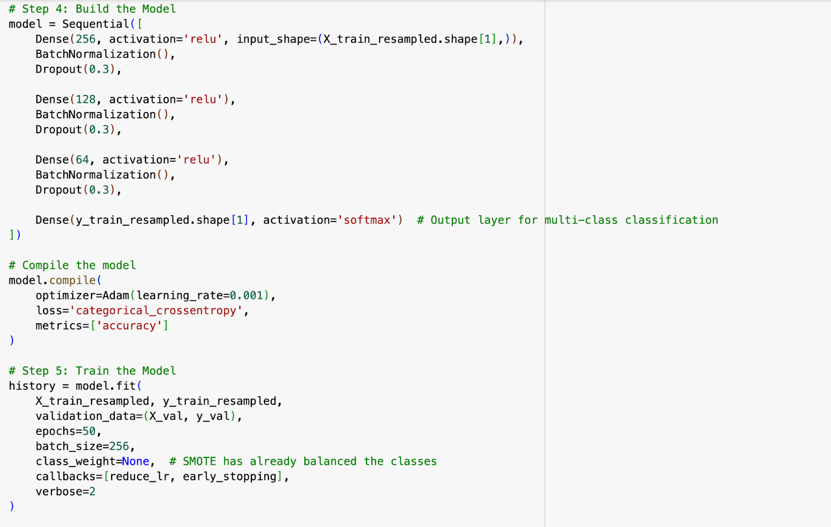
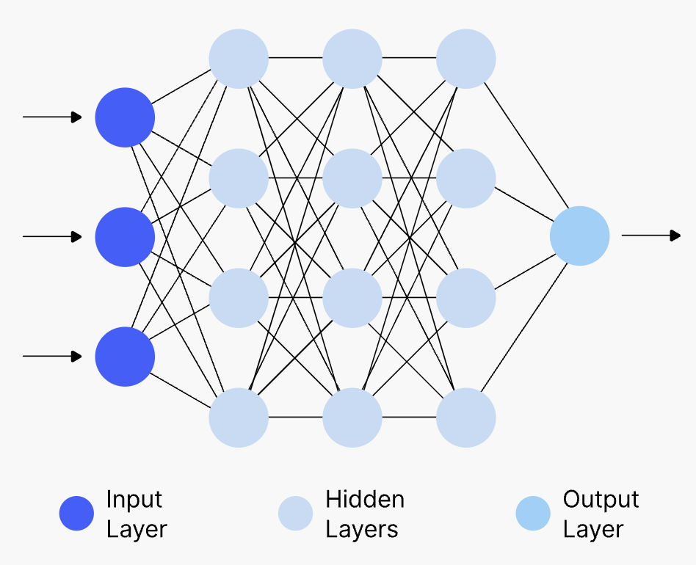

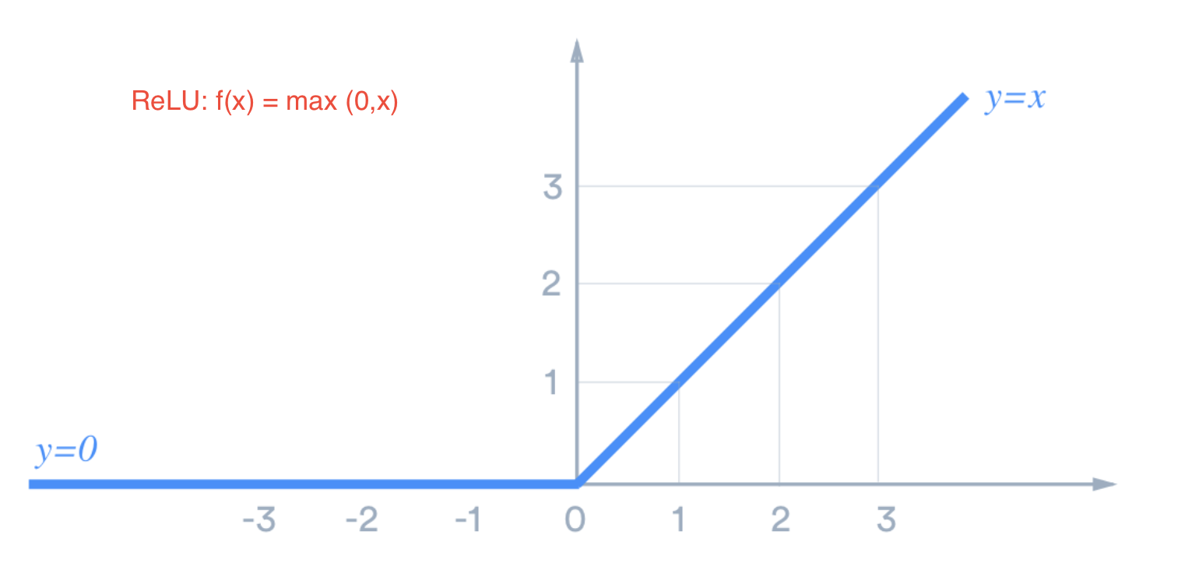
MODEL BUILDING- NUEUARL NETWORK

Slide 19
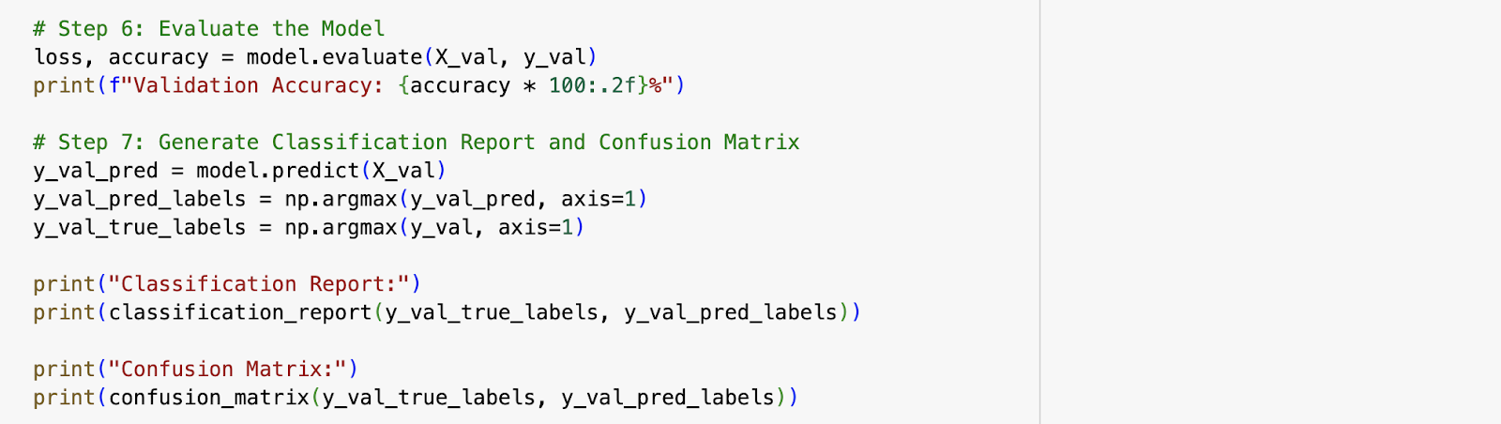
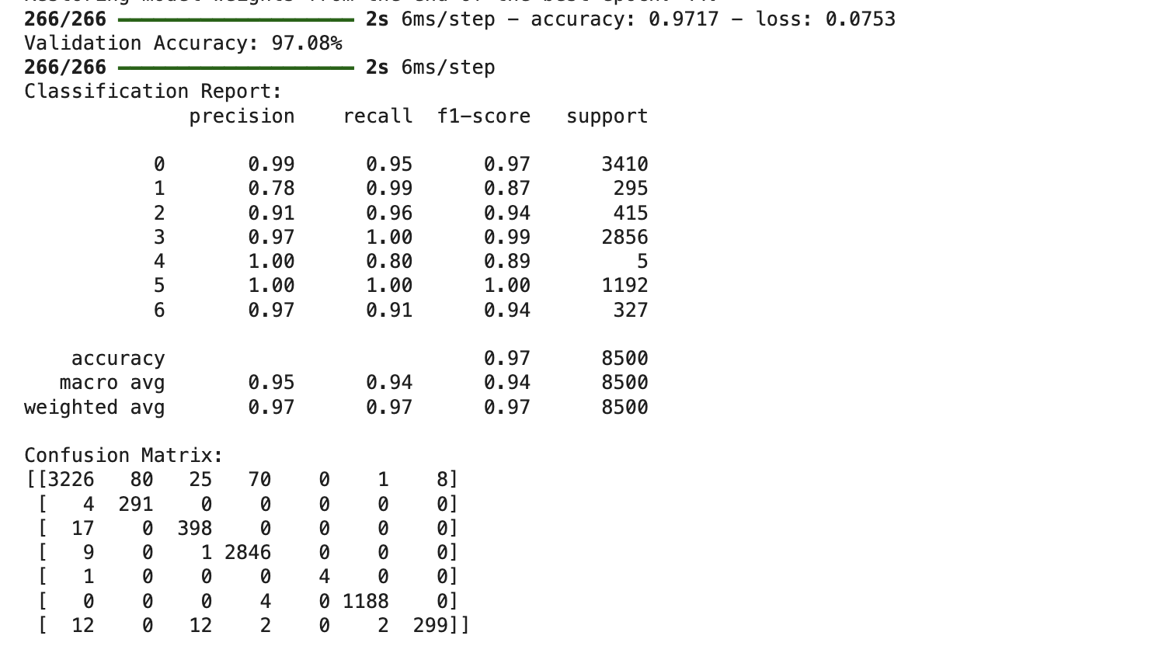
Model Evaluation and Performance
97.08%
Accuracy
High precision in detecting intrusions
0.96
Avg. F1 Score
Balanced precision and recall
~6ms
Response Time
Real-time threat detection capability

Slide 20
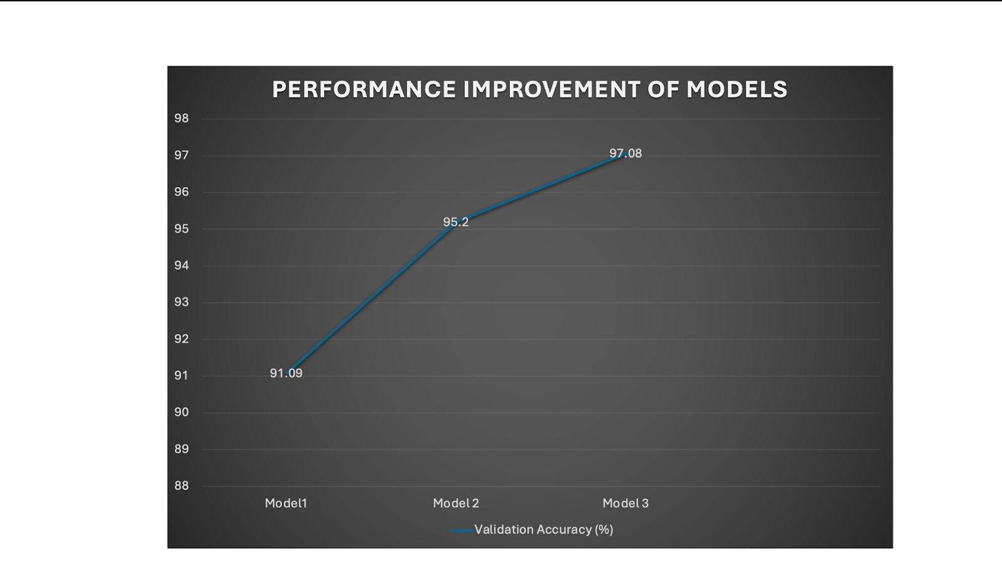

Slide 21
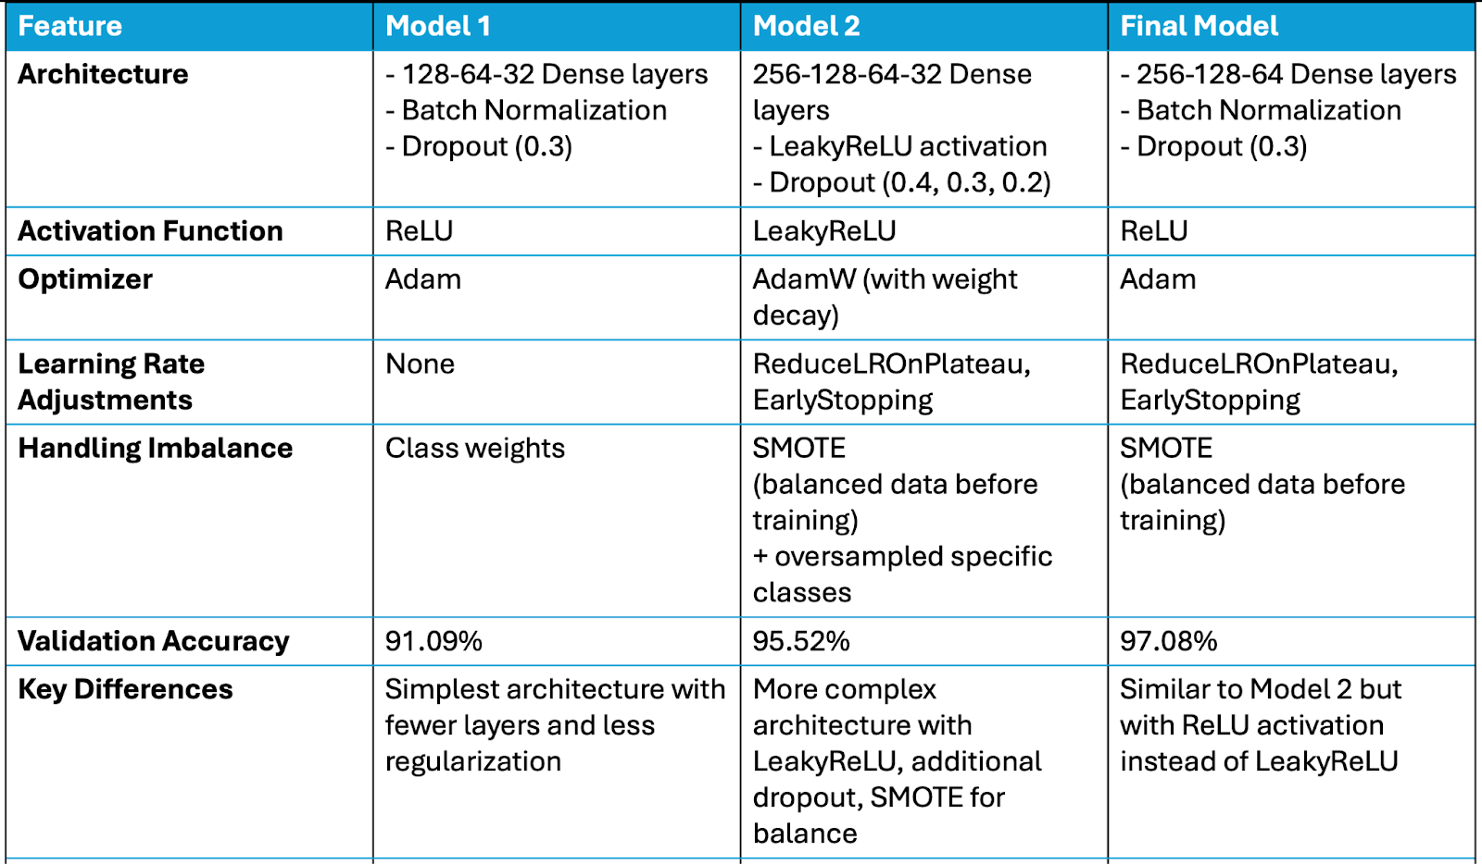

Slide 22




Future Work and Scope
Adversarial Training
1
Improve resilience against evolving threats
Edge Computing Integration
2
Enhance real-time processing capabilities, deploying IDS on edge devices
For faster detection and response times without relying on cloud-base sol.
Real Time Monitoring
3
Anomaly Detection- identify unusual patterns in V2V and V2I
Scalability Across IoV Systems
4
Adapt IDS for various IoV ecosystems, such as smart cities, etc.

Slide 23
THANKYOU!

